Slide 1
Disclosure
Viya 4 supports SAS Studio Custom Tasks
Viya 4 has a sibling or cousin to Custom Tasks called Custom Steps
Custom Steps has same concept but different language supporting
Custom Tasks = HTML + Velocity Scripting Language
Custom Steps = Leverages JSON
Custom Steps are Viya based, not available in 9.4
Which is better ? Custom Task or Step?
High level: accomplish same thing, just different technology under the covers
Tasks and Steps are not perfect for every situation
Because Tasks and Steps accomplish the same goal using different technology there has been hints that at some point SAS will drop support for Custom Tasks in the future

Slide 2
Changing from Task to Step
Why previous disclosure should not stop you from leveraging Custom Tasks in 9.4
Large part of a Custom Task or Step is having a business logic flow combined with user selections.
Example: If user selects check box to include IBNR or Credit Loss Reserves, then a drop down becomes visible providing different methods for calculating Reserves
The business logic flow does not change from task to step. You can manually translate a custom task to a custom step
Manual process
Not difficult – does take time in beginning
Learning curve that quickly collapses
Detail oriented
Realistic to expect limited adoption of Custom Tasks as they are not ad hoc

Slide 3
Adoption Expectation
Common to have hundreds or thousands of ad hoc EG projects
Custom Tasks are not ad hoc
Well thought out
Custom Tasks solve a specific business problem that occurs regularly
Expectation is you would have a limited number of Custom Tasks
Guestimate: 5 - 25
Custom Tasks you do have would be valuable assets
Not all SAS users will build Custom Tasks
Git Hub Repository of Custom Tasks (resources slide)

Slide 4
SAS Studio 3.8 Custom Tasks for 9.4
Why build a Custom Task?
Code reusability
Guide new analyst on correct syntax
Proc sort nodupkey
Merges
Writing code to submit to a grid
Capable of building complex processes when combined with SAS Studio flows
Serve up analytics to non-analytical or analyst that lack programming skills
Examples that could be created
Underwriting: Rate up complex applications
Ultimate Loss Reserve Process via Custom Tasks and Flows
If you have a business process that is performed regularly that is complex or challenging, you should consider SAS Studio Custom Tasks
Not EG vs. SAS Studio: Better approach is to use both in 9.4

Slide 5
SAS Studio 3.8 vs. 5.2
Custom Tasks are Powerful
Balance between ease and features
Won’t be able to meet every need
SAS Studio 3.8
Last version for 9.4
SAS Studio 5.2
Not in Kansas anymore, complete departure from 3.8
Rewritten in html5
Supports Viya 3.5 and 9.4
5.2 steps backward in feature capability compared 3.8
Due to html5 rewrite
No reason to use this version better versions\options for SAS Studio exist

Slide 6
Useful Tools for Custom Tasks
Need a good text compare software
I use Notepad ++ compare plugin
Better compare software's exist
Need HTML editor
I use Notepad ++

Slide 7
Three Main Components of Custom Task
Metadata (HTML Code)
Objects you will be working with
Tables, labels, text box, radio button, check box, list box….many more
User Interface Screen - UI (HTML Code)
If object not in the UI section, the object is not seen in the interface
If using an existing task as starting point
Not unusual to have 100 objects in Metadata, only use 5 objects in input screen
Not using objects listed in Metadata in UI is harmless
Code (Velocity Code)
This is where you combine your SAS code with user input selections

Slide 8
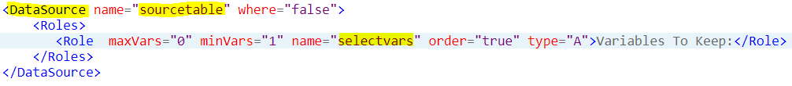
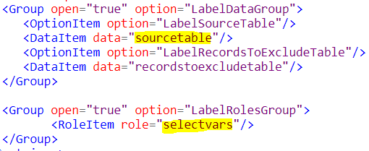
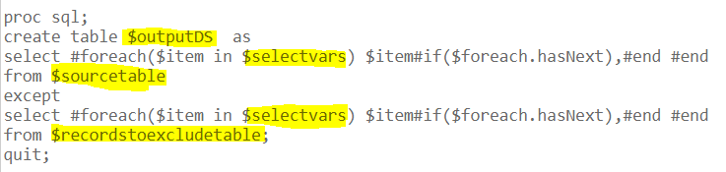
Three Main Components of Custom Task
1 Metadata (HTML Code)
Objects: Below data source and one variable from data source
2 User Interface Screen - UI (HTML Code)
Objects that will accept user input
3 Code (Velocity Code)
Combine SAS code with user input

Slide 9
Two Ways to Build Custom Task
Take existing task and modify it to suit your needs
Pros
Work faster
Objects you require already exist, declared and integrated with SAS code
Cons
Can be overwhelming, confusing to analyst just starting to build custom task as vast majority of code will not apply to their situation. If task requires 100 lines of code, using an existing task might have 500 lines of code and 400 of those lines need to be commented out
Create task from scratch
Pros
Easier to see and understand the process
Great learning first step – create from scratch simple task
Cons
Slower – every object must be created, declared and integrated with SAS code
If object not in the UI section, the object is not seen in the interface
Not unusual to have 100 objects in Metadata, only use 5 objects in input screen
Not using objects listed in Metadata in UI is harmless
Code (Velocity Code)
This is where you combine your SAS code with user input selections

Slide 10
Tips for Custom Tasks
At least ½ your time will be spent designing flow – business rules
Commenting out HTML
<--! Html code --> (this is commented out)
Comment out Velocity code
Single line: ## (put two hash tags at start of line
Multi line: #* to start comment out
Multi line: *# to end comment out
Sample Task in SAS Studio is great for learning
Make simple changes to Sample Task and visually see the impact
If you open a task and the data source does not exist
Will generate error
Simple fix: close task, generate data and then re-open task

Slide 11
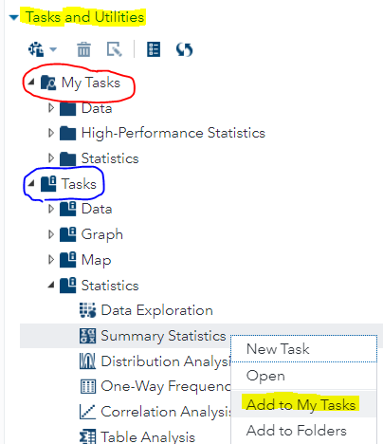
Creating Custom Task Starting with Existing Task
Pick a starting task that is like what you require
In my SQL Except example, started with Proc Sort Task
Where would I find existing Task?
Hundreds of Task examples written by SAS
Open the Tasks folder containing Tasks written by SAS (blue)
Select task that meets or is close to your requirements
Right click desired task
Select Add to My Task (yellow bottom right)
Now you can edit task in your folder
called My Task (red)
Cannot edit the SAS Written Tasks without first
copying task to your My Task folder
Comment out code, do not delete
Commenting out makes for easier comparison to original

Slide 12
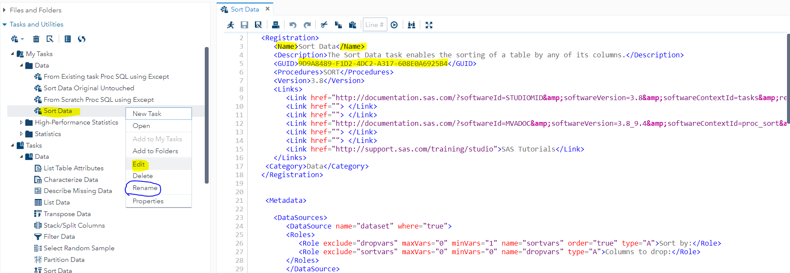
Creating Custom Task Starting with Existing Task (2)
Right click the task you copied into your My Tasks folder or sub-directory
Select edit and you will get the screen below
All tasks must have a unique GUID
Line 5 in yellow: Change some numeric\character values
Save task (ctm file)

Slide 13
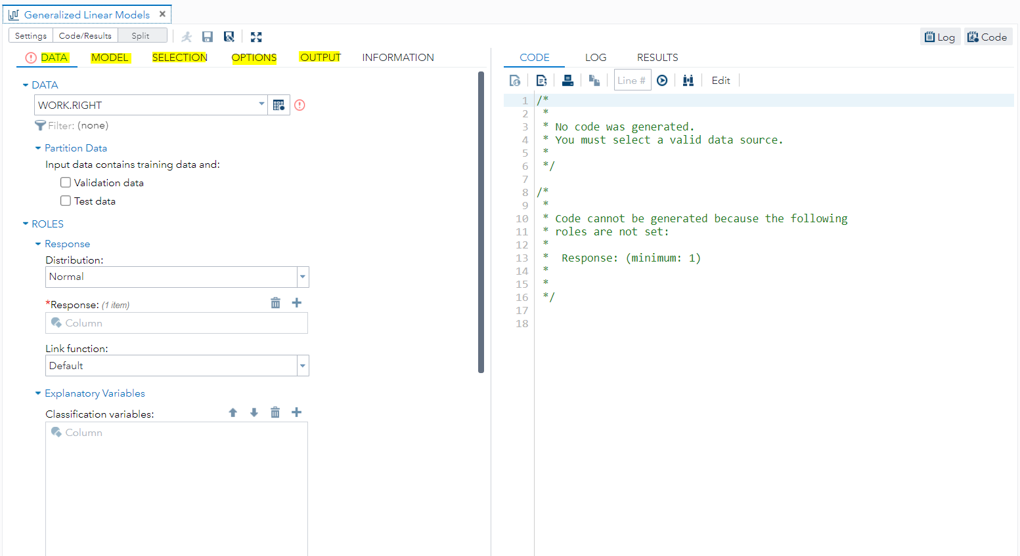
Custom Tasks Can Be Complex and Support Processes
Tasks can be complex. This task has 5 tabs and is out of the box written by SAS. However, you can add as many objects and code as your process requires.

Slide 14
Resources for Creating SAS Custom Tasks
Writing your first SAS Custom Task
SAS Custom Task Cheat Sheets
Git Hub of SAS Custom Tasks
Developers Guide to Writing Custom Tasks
Velocity Language User Guide

